Slide 1
Smart Travel Planner using AI
CAPSTONE PROJECT
Presented By: EduNet
Student name : G. Keerthi
College Name & Department : KL University, CSE

Slide 2
OUTLINE
Problem Statement
Technology used
Wow factor
End users
Result
Conclusion
Git-hub Link
Future scope
IBM Certifications

Slide 3
Problem Statement
Students, solo travelers, and trip planners often struggle to find trustworthy, personalized, and up-to-date travel recommendations that match their preferences, budget, and schedule. Sifting through hundreds of travel blogs, scattered reviews, and tourism websites is time-consuming and often leads to decision fatigue. Additionally, there is no unified platform that combines real-time data, smart itinerary planning, and contextual insights for diverse travel needs.
Proposed Solution: An AI-powered Travel Assistant that uses Natural Language Processing (NLP) and Retrieval-Augmented Generation (RAG) to help users efficiently plan personalized trips. It generates smart itineraries, suggests destinations, recommends transport and accommodation, and provides real-time insights like weather, crowd levels, and local events—all through a conversational interface.

Slide 4
Technology used
IBM cloud lite services
Natural Language Processing (NLP)
Retrieval Augmented Generation (RAG)
IBM Granite model

Slide 5
IBM cloud services used
IBM Cloud Watsonx AI Studio
IBM Cloud Watsonx AI runtime
IBM Cloud Agent Lab
IBM Granite foundation model

Slide 6
Wow factors
This AI-powered Travel Planning Agent aims to revolutionize the way individuals and groups plan their trips by significantly reducing the time, effort, and uncertainty involved in organizing travel. By leveraging IBM’s Natural Language Processing (NLP), Retrieval-Augmented Generation (RAG), and the Granite foundation model, the agent offers intelligent, personalized, and real-time travel assistance. It understands user queries in natural language and generates custom itineraries tailored to preferences such as budget, travel style, and duration. Unique features include semantic search for destinations, local experiences, and events; auto-generation of day-wise plans; and a smart cost estimator that breaks down expenses using real-time data. The system also provides live updates on weather, safety alerts, and crowd density to optimize travel timing and choices. In addition, it performs travel trend analysis over time, suggesting emerging or less crowded locations based on user interests. The agent encourages collaborative planning by allowing groups to co-create itineraries and manage shared expenses. Sustainability is also a key focus, with eco-friendly suggestions such as local transport, green accommodations, and low-emission routes. Overall, this agent enhances travel planning by making it faster, smarter, more personalized, and environmentally conscious.

Slide 7
End users
Solo Travellers
Students & Budget Travellers
First Time Travellers
Content creators/Bloggers

Slide 8
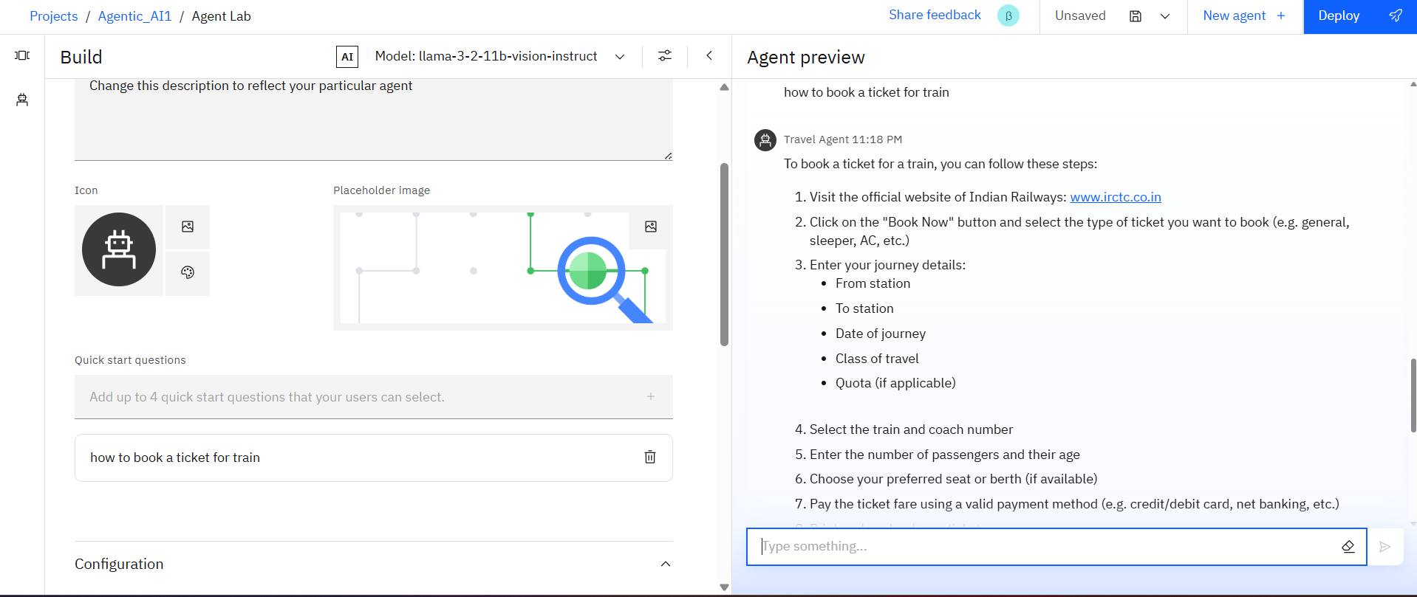
Results

Slide 9
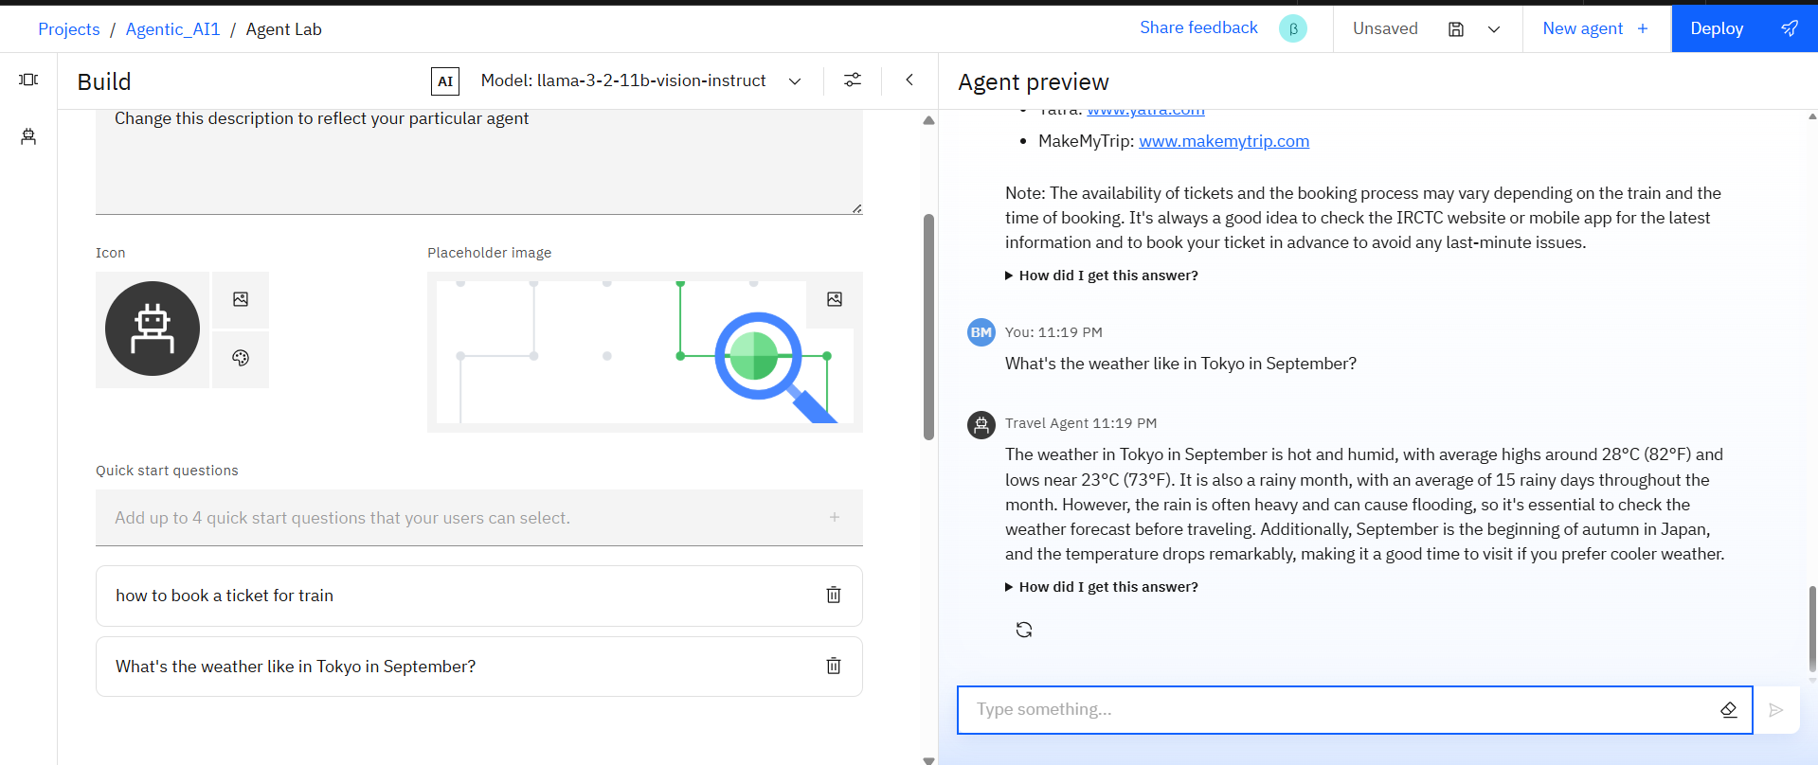
Results

Slide 10
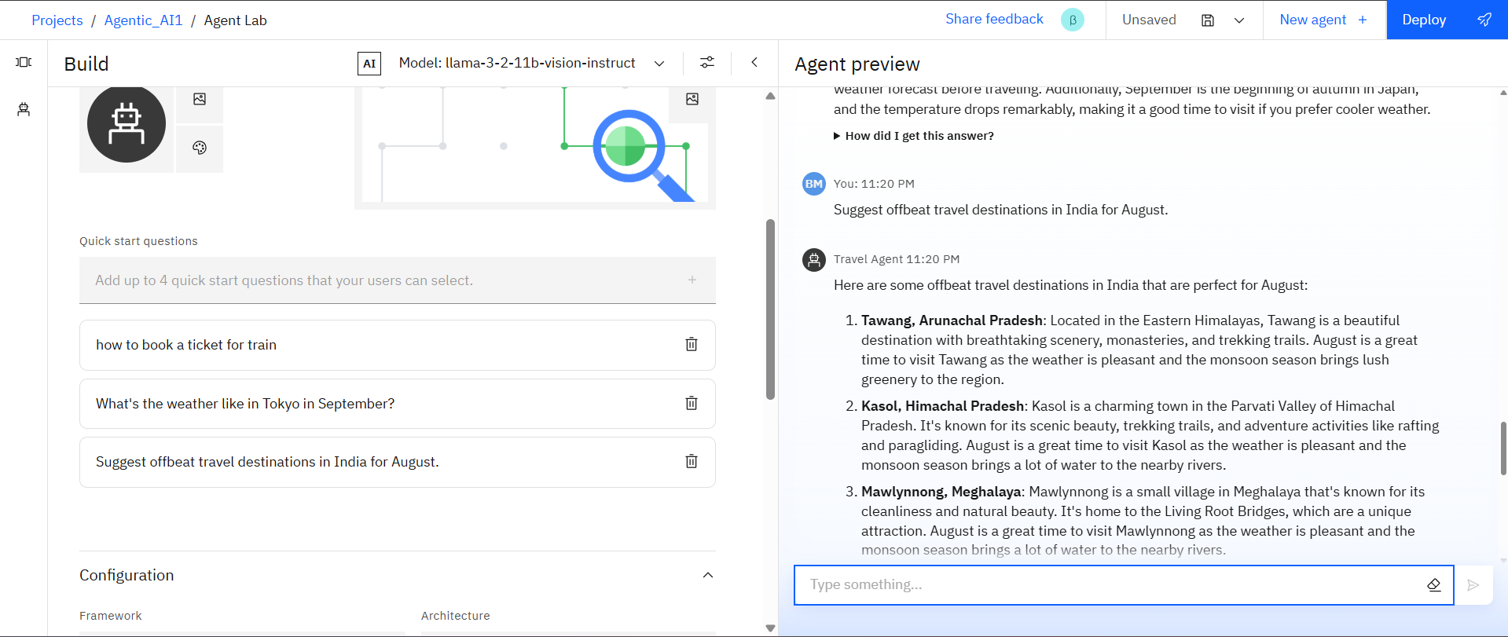
Results
Deployed the ai agent successfully

Slide 11
Conclusion
The Travel Planning Agent can generate complete travel itineraries, suggest destinations based on user preferences, and even draft detailed travel plans including estimated budgets, routes, and daily activities. It saves time by automating repetitive and tedious tasks such as cost estimation, weather checking, and activity scheduling. By integrating real-time data and user context, the agent enhances the accuracy and relevance of travel suggestions. Whether used by individuals or businesses, this intelligent assistant boosts efficiency, personalization, and satisfaction in travel planning. It empowers users to focus more on enjoying the journey rather than being overwhelmed by the logistics.
Ask ChatGPT

Slide 12
Future scope
Integration of Augmented Reality (AR):
Allow users to preview destinations, hotels, and landmarks virtually.Voice-Activated Research Assistant
Voice Assistant Integration:
Enable hands-free, conversational trip planning and real-time navigation support.Research Gap and Novel Topic Identification
Personalized Travel Insurance & Safety Alerts:
Recommend insurance options and give proactive alerts for health, weather, or political situations.AI-Assisted Paper Drafting

Slide 13
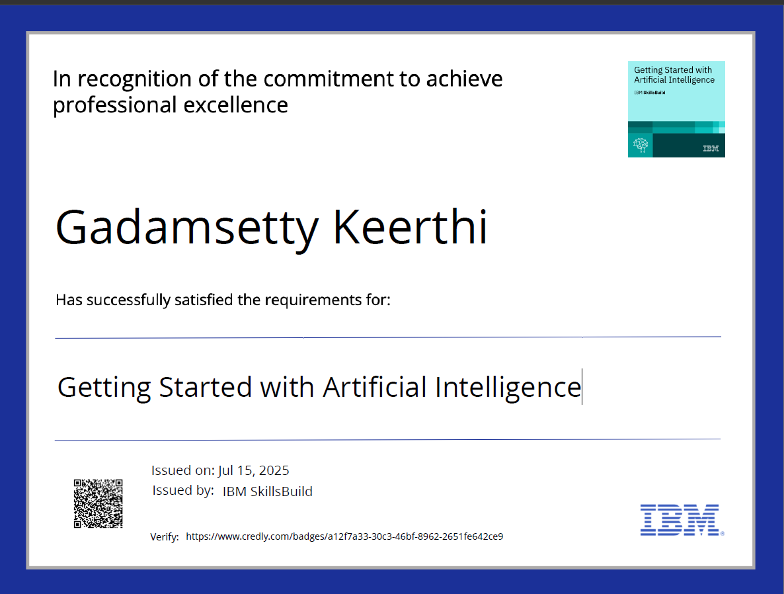
IBM Certifications
Screenshot/ credly certificate( getting started with AI)

Slide 14
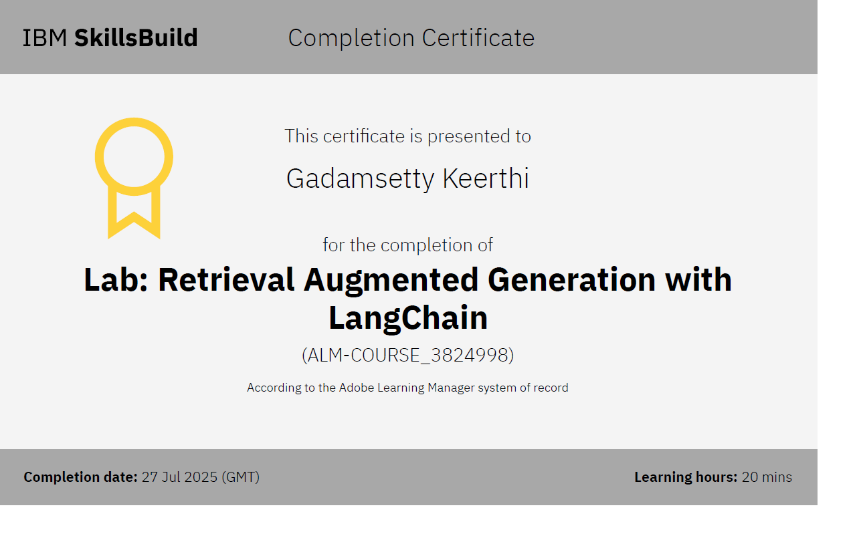
Attach your RAG LAB certificate here

Slide 15
Git hub lik : https://github.com/AswiniKumar55/Nutrion_agent

Slide 16
GitHub Link
Make sure that there should be readme file

Slide 17
THANK YOU

